Slide 1
RESTAURANT RATINGS PREDICTIONS
Team ABCD
A – Anubhav Ghosh
B – Bibekananda Mishra
C – Chiranjeevi Pippalla
D – Dinesh Dandamudi

Slide 2
OUTLINE
What are the topics we are going to see now?
Introduction
Data Pre-processing
EDA
Linear Regression
Decision Tree Regression
Random Forest Regression
Recommendations
Anomalies
Conclusion

Slide 3
Introduction
What is this project about?
Basic idea of analyzing this dataset is to get a fair idea about the factors affecting the establishment of different types of restaurants at different places in Bangalore.
Predicting the ratings of the restaurants in Bangalore is mainly based on
Location of the restaurant
Most liked cuisine
Most liked dish
Average cost for two people

Slide 4
Introduction
Role of Data-Science
Use classification / regression techniques to make predictions
Explore the factors that play important roles in business

Slide 5
DATA EXPLORATION

Slide 6
DATASET
Features
url, address
name
Online order
Votes
Location
Restaurant type
Dish liked
Cuisines
Review list
Menu item
Listed in (type)
Listed in (city)

Slide 7
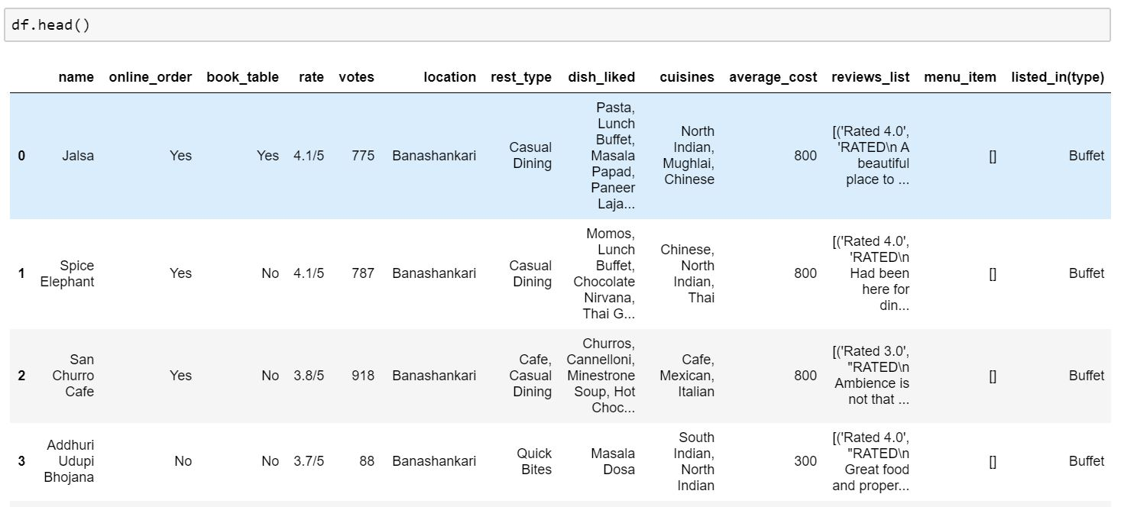
DATA EXPLORATION
Data after dropping unnecessary columns and rows

Slide 8
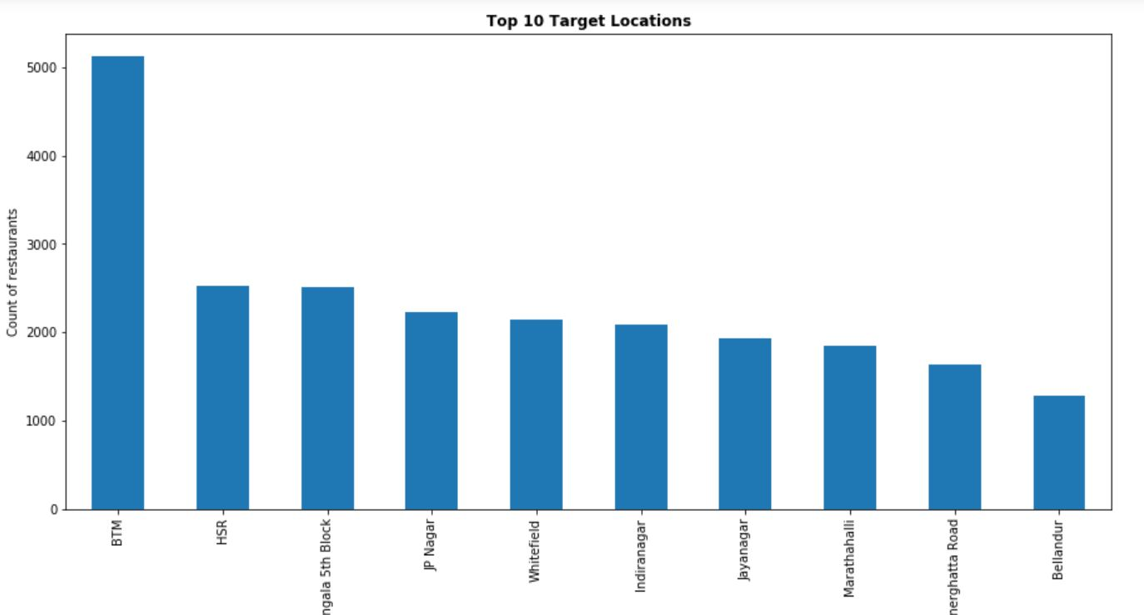
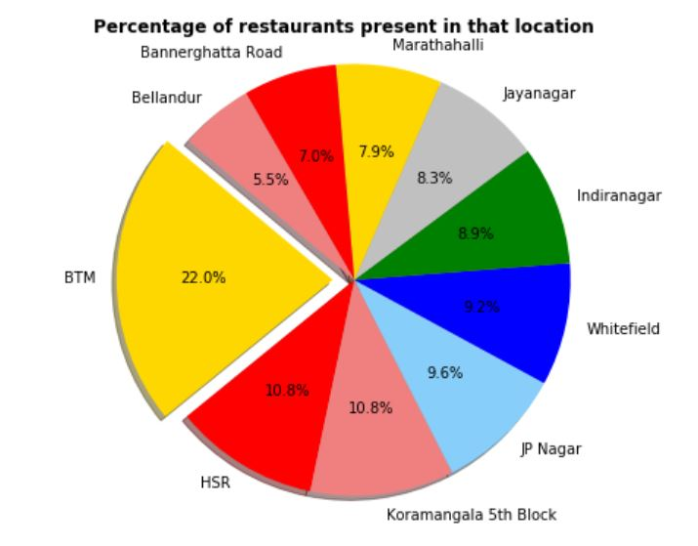
DATA EXPLORATION
TOP 10 TARGET LOCATIONS

Slide 9
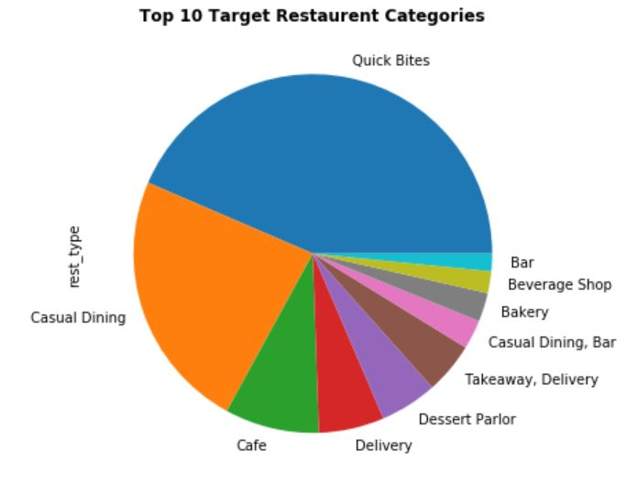
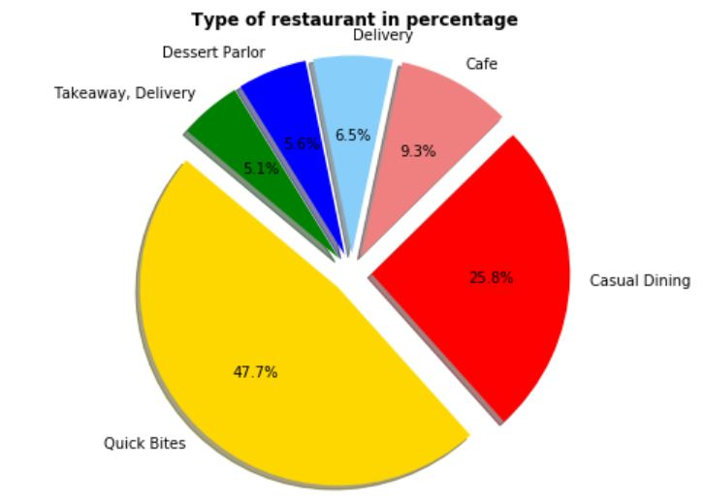
DATA EXPLORATION
TOP 10 TARGET RESTAURANT CATEGORIES

Slide 10
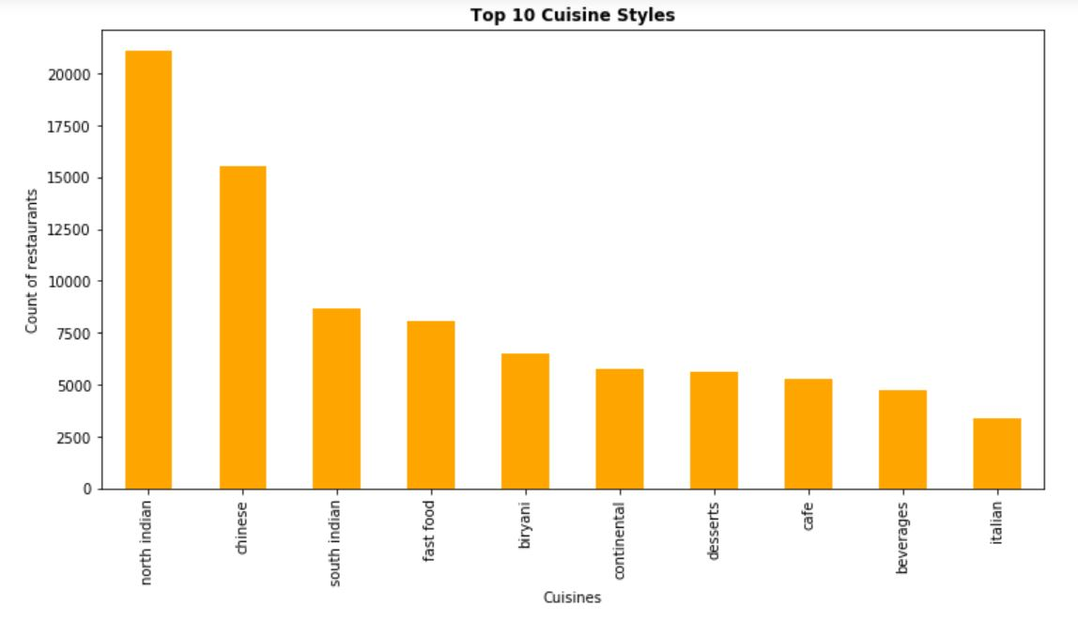
DATA EXPLORATION
TARGET CUISINE STYLE

Slide 11
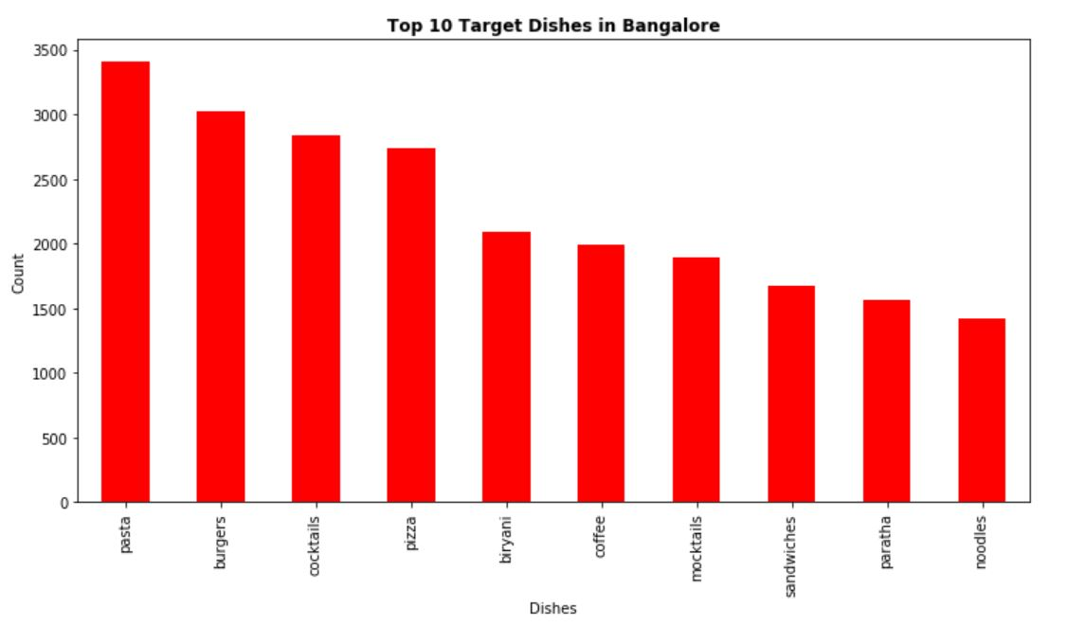
DATA EXPLORATION
TARGET DISH

Slide 12
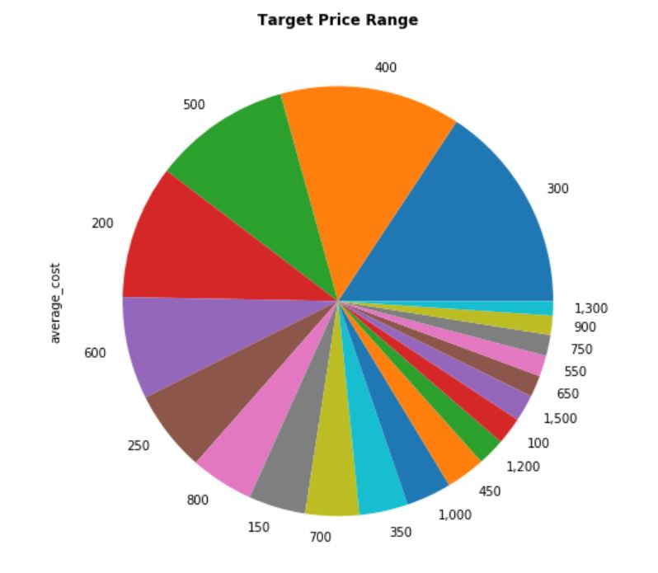
DATA EXPLORATION
TARGET PRICE

Slide 13
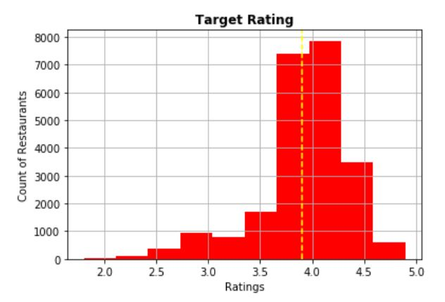
DATA EXPLORATION
TARGET RATING

Slide 14
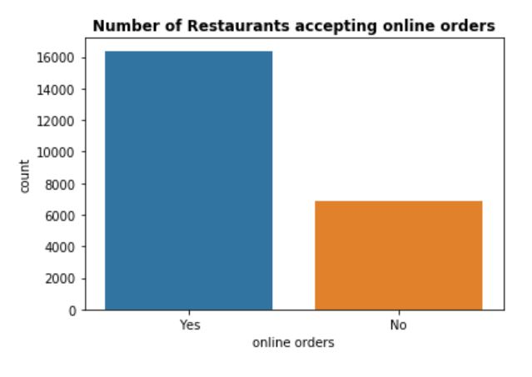
DATA EXPLORATION
TARGET RATING

Slide 15
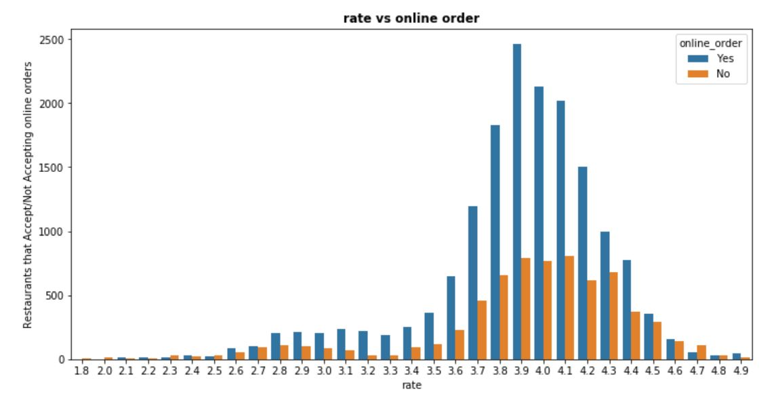
DATA EXPLORATION
RATING VS ONLINE ORDER

Slide 16
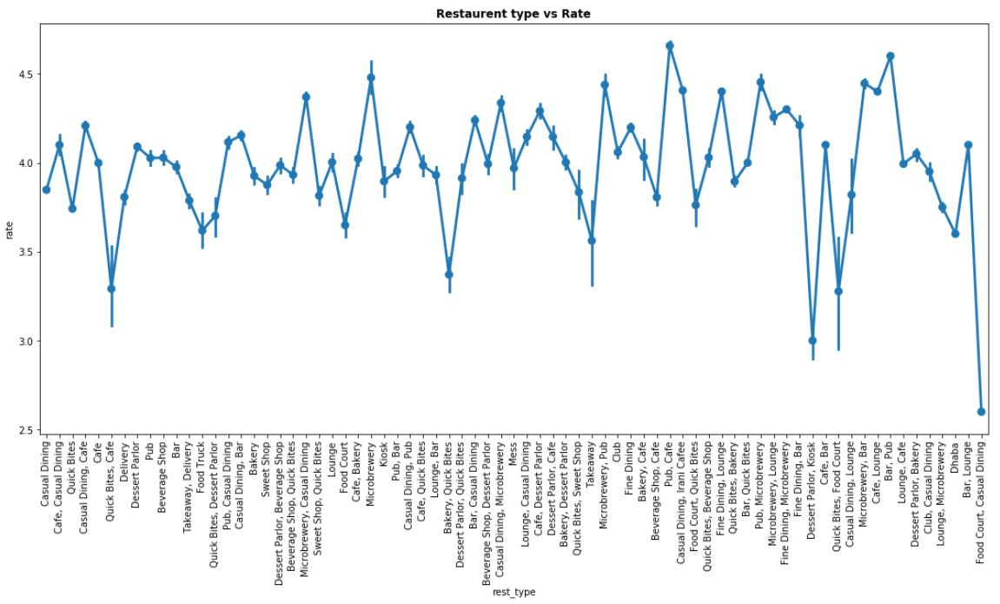
DATA EXPLORATION
RESTAURANT TYPE vs. RATING

Slide 17
LINEAR REGRESSION

Slide 18
Dataset: LINEAR REGRESSION
Analysis
Classifier: Column values
Feature selection
Accuracy

Slide 19
RANDOM FOREST CLASSIFIER

Slide 20
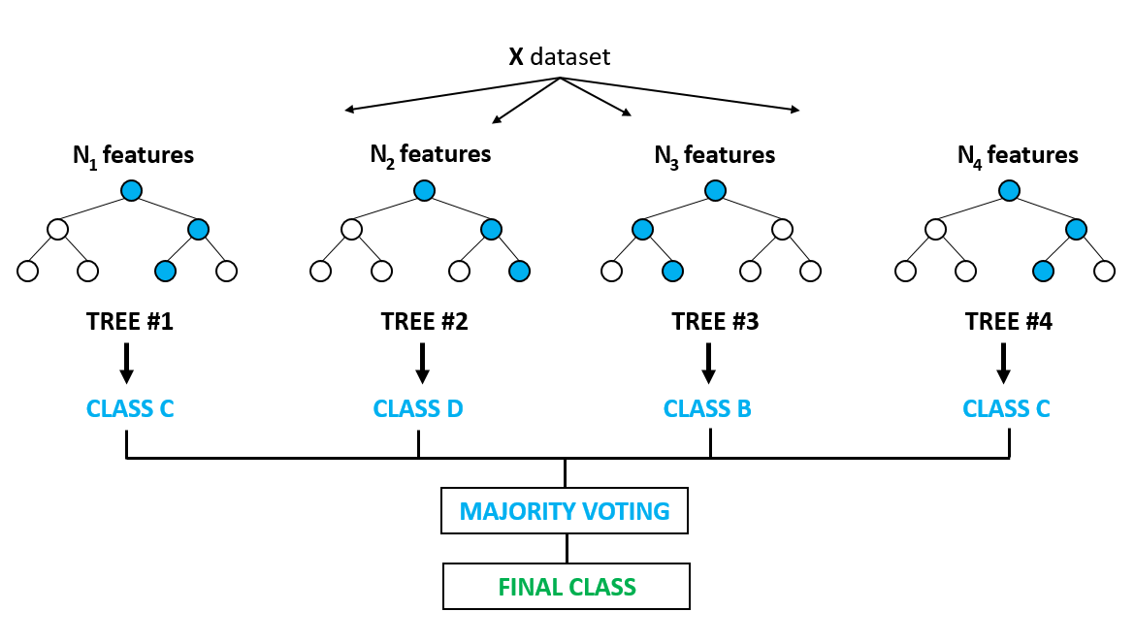
Dataset: RANDOM FOREST CLASSIFIER
Short Notes
We use the technique of Bagging which is also called Bootstrap Aggregator
Boot strapping
Aggregator

Slide 21
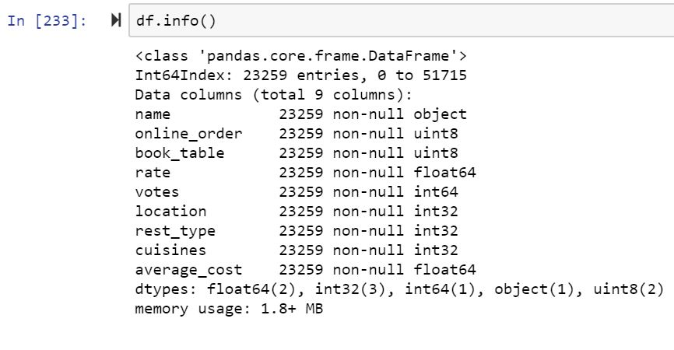
Dataset: RANDOM FOREST CLASSIFIER
Analysis
Classifier: Column values
Feature selection
Accuracy

Slide 22
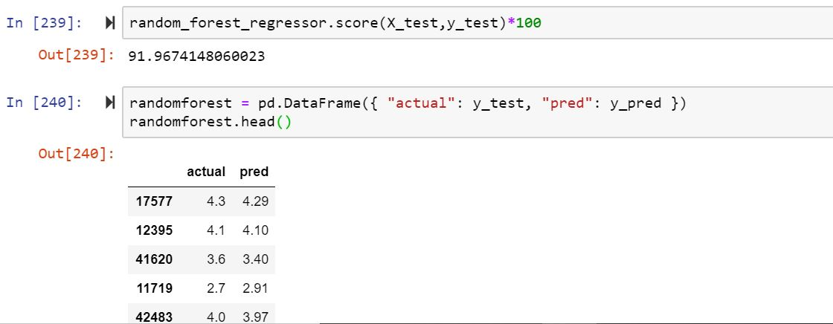
Dataset: RANDOM FOREST CLASSIFIER
Analysis
Classifier: Column values
Feature selection
Accuracy

Slide 23
DECISION TREE CLASSIFIER

Slide 24
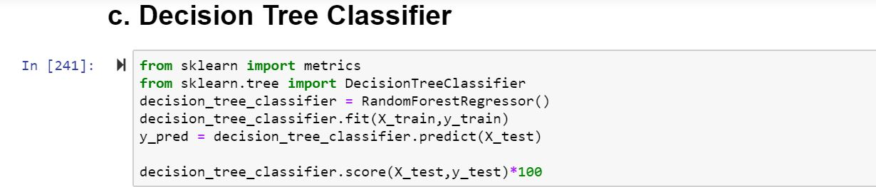
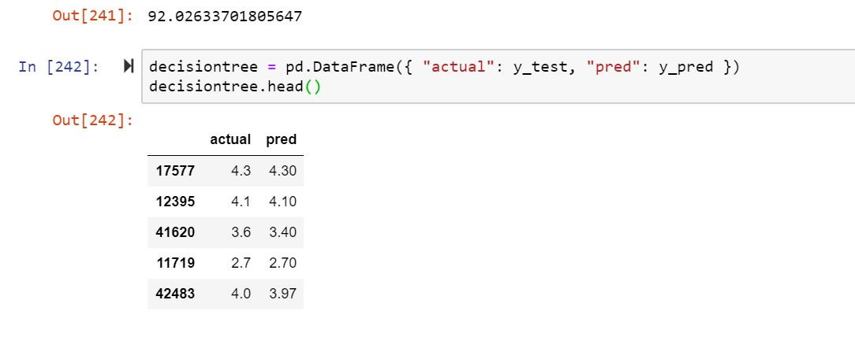
Dataset: DECISION TREE CLASSIFIER
Analysis
Classifier: Column values
Feature selection
Accuracy

Slide 25
Learning outcomes
EECS-731
Understood the complications involved in working on datasets and making hypothesis.
Spent multiple weeks on finding / exploring and (ultimately) discarding multiple datasets related to restaurants and analysis from a number of online sources
More clarity on how to collect quality data when working with classifications, regression and recommendations.
More finely tuned data -> better predicting models
Used a number of algorithms from this course
Better understanding of the nuances involved in using these algorithms for answering practical questions

